Slide 1
Probability
Events, Compliment, intersection, Union, Venn Diagram

Slide 2
EVENTS
For any given experiment, we may be interested in the occurrence of certain events rather than in the occurrence of a specific element in the sample space.
For instance, we may be interested in the event A that the outcome when a die is tossed is divisible by 3. This will occur if the outcome is an element of the subset A = {3, 6} of the sample space S1.
As a further illustration, we may be interested in the event B that the number of defectives is greater than 1 in Example 2.3. This will occur if the outcome is an element of the subset B = {DDN, DND, NDD, DDD} of the sample space S.

Slide 3
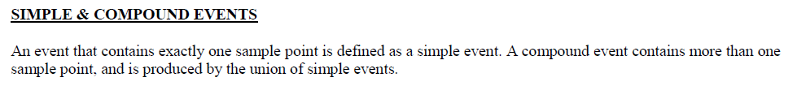
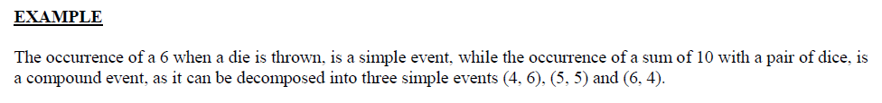
Definition 2.2: An event is a subset of a sample space.
Example 2.4: Given the sample space S = {t | t ≥ 0}, where t is the life in years of a certain electronic component, then the event A that the component fails before the end of the fifth year is the subset A = {t | 0 ≤ t < 5}.

Slide 4
It is feasible that an event may be a subset that includes the entire sample space S or a subset of S called the null set and denoted by the symbol φ, which contains no elements at all.
For instance, if we let A be the event of detecting a microscopic organism by the naked eye in a biological experiment, then A = φ.
Also, if B = {x | x is an even factor of 7}, then B must be the null set, since the only possible factors of 7 are the odd numbers 1 and 7.

Slide 5
Complement
Consider an experiment where the smoking habits of the employees of a manufacturing firm are recorded. A possible sample space might classify an individual as a nonsmoker, a light smoker, a moderate smoker, or a heavy smoker.
Let the subset of smokers be some event. Then all the nonsmokers correspond to a different event, also a subset of S, which is called the complement of the set of smokers.

Slide 6
Definition 2.3:
The complement of an event A with respect to S is the subset of all elements of S that are not in A. We denote the complement of A by the symbol A .
Example 2.5:
Let R be the event that a red card is selected from an ordinary deck of 52 playing cards, and let S be the entire deck. Then R is the event that the card selected from the deck is not a red card but a black card.
Example 2.6:
Consider the sample space S = {book, cell phone, mp3, paper, stationery, laptop}. Let A = {book, stationery, laptop, paper}. Then the complement of A is A = {cell phone, mp3}.

Slide 7
Intersection
We now consider certain operations with events that will result in the formation of new events. These new events will be subsets of the same sample space as the given events.
Suppose that A and B are two events associated with an experiment. In other words, A and B are subsets of the same sample space S.
For example, in the tossing of a die we might
let
A be the event that an even number occurs
and
B the event that a number greater than 3 shows.
Then the subsets A = {2, 4, 6} and B = {4, 5, 6} are subsets of the same sample space
S = {1, 2, 3, 4, 5, 6}.
Note that both A and B will occur on a given toss if the outcome is an element of the subset {4, 6}, which is just the intersection of A and B.

Slide 8
Definition 2.4:
The intersection of two events A and B, denoted by the symbol A ∩ B, is the event containing all elements that are common to A and B.
Example 2.7:
Let E be the event that a person selected at random in a classroom is majoring in engineering, and let F be the event that the person is female. Then E ∩ F is the event of all female engineering students in the class.
Example 2.8:
Let V = {a, e, i, o, u} and C = {l, r, s, t}; then it follows that V ∩ C = φ. That is, V and C have no elements in common and, therefore, cannot both simultaneously occur.

Slide 9
Mutually exclusive
For certain statistical experiments it is by no means unusual to define two events, A and B, that cannot both occur simultaneously. The events A and B are then said to be mutually exclusive.
Stated more formally, we have the following definition:
Definition 2.5:
Two events A and B are mutually exclusive, or disjoint, if A ∩ B = φ, that is, if A and B have no elements in common

Slide 10
Union
Often one is interested in the occurrence of at least one of two events associated with an experiment.
Thus, in the die-tossing experiment, if A = {2, 4, 6} and B = {4, 5, 6}, we might be interested in either A or B occurring or both A and B occurring.
Such an event, called the union of A and B, will occur if the outcome is an element of the subset {2, 4, 5, 6}.
Definition 2.6:
The union of the two events A and B, denoted by the symbol A∪B, is the event containing all the elements that belong to A or B or both.
Example 2.10:
Let A = {a, b, c} and B = {b, c, d, e}; then A ∪ B = {a, b, c, d, e}.

Slide 11
Example 2.11:
Let P be the event that an employee selected at random from an oil drilling company smokes cigarettes. Let Q be the event that the employee selected drinks alcoholic beverages. Then the event P ∪ Q is the set of all employees who either drink or smoke or do both
Example 2.12:
If M = {x | 3 <x< 9} and N = {y | 5 <y< 12},
Then
M ∪ N = {z | 3 <z< 12}

Slide 12
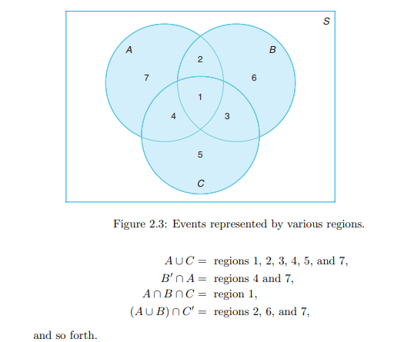
The relationship between events and the corresponding sample space can be illustrated graphically by means of Venn diagrams. In a Venn diagrams. we let the sample space be a rectangle and represent events by circles drawn inside the rectangle.
Thus, in Figure 2.3,
we see that A ∩ B = regions 1 and 2,
B ∩ C = regions 1 and 3

Slide 13
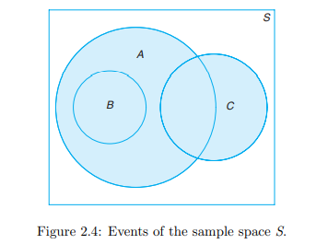
In Figure 2.4, we see that events A, B, and C are all subsets of the sample space S. It is also clear that event B is a subset of event A; event B ∩ C has no elements and hence B and C are mutually exclusive; event A ∩ C has at least one element; and event A ∪ B = A.
Figure 2.4 might, therefore, depict a situation where we select a card at random from an ordinary deck of 52 playing cards and observe whether the following events occur:
A: the card is red, B: the card is the jack, queen, or king of diamonds, C: the card is an ace.
Clearly, the event A ∩ C consists of only the two red aces.

Slide 14
Exercise
Questions # 2.1, 2.2, 2.3, 2.4, 2.5, 2.6, 2.8, 2.9, 2.14, 2.15

